Slide 1



Integrated Program in Business Analytics
FIFA Dataset
- International Football Matches from 1990 to World Cup 2022
Group N
Team BLU.EST

Slide 2


Presentation headway
Objectives
&
EDA
Business objectives
Visualization
Modeling
Model Development
Simulation
&
Conclusion
Treating NaNs
Treating Outliers
Business conclusions
Data type transformation
About the data set
Business Findings
Live tracking
Tableau Dashboard
Key Insights
Correlations
Data Split
Model evaluation and accuracy
Simulations
By Dheeraj & Shubham
By Prashant, Rishabh & Rahul
By Sachin
By Ankit & Rahul

Slide 3
Presentation headway
Business objectives
About the data set
Data type transformation
Treating NaNs
Treating Outliers
By Dheeraj & Shubham

Slide 4




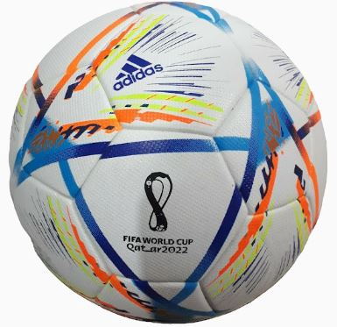

Business problems and objectives
With teams interest in sports and the entire world waiting for FIFA World Cup we undertook the project with below objectives under guidelines of Ankur Mawandia.
Predicting which team is most likely to win the 2022 FIFA World Cup
Is there really such a thing as a home team advantage
Does the best team always win? Can we explain why a weaker team sometimes win? Can we identify top teams based on available parameters?
Do teams with stronger offense players score more goals? And do teams with stronger goalkeepers receive fewer goals?
To show continent and countries where most number of football matches are played.
To give a complete overview of all international soccer matches played since the 90s
To show which team has the strongest defence, midfield, and offense players
To show which team has the longest winning streak.

Slide 5

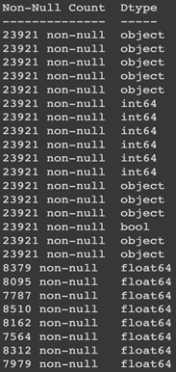
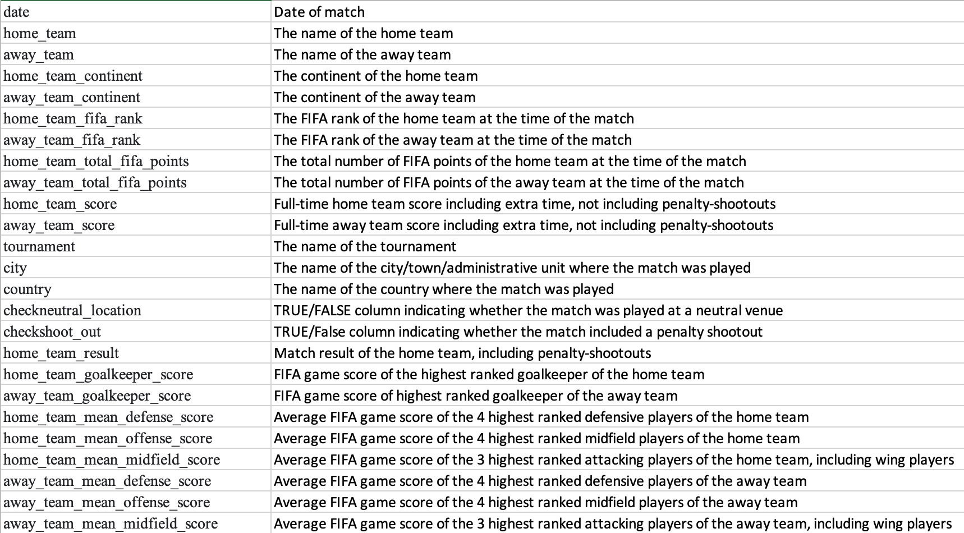
Dataset references
Kaggle data set with 25 columns and 23921 records, This dataset provides a complete overview of all international football matches played since the 1990s. In addition, the strength of each team is provided in terms of scores based on Goalkeeper, Midfield, Offense and Defence players along with actual FIFA rankings.

Slide 6
Data Preparation
Transformations of data type
To extract years, months, days for EDA
date
to_datetime
object
datetime64
For EDA and Data models
neutral_location
Label encoding
bool
int64

Slide 7
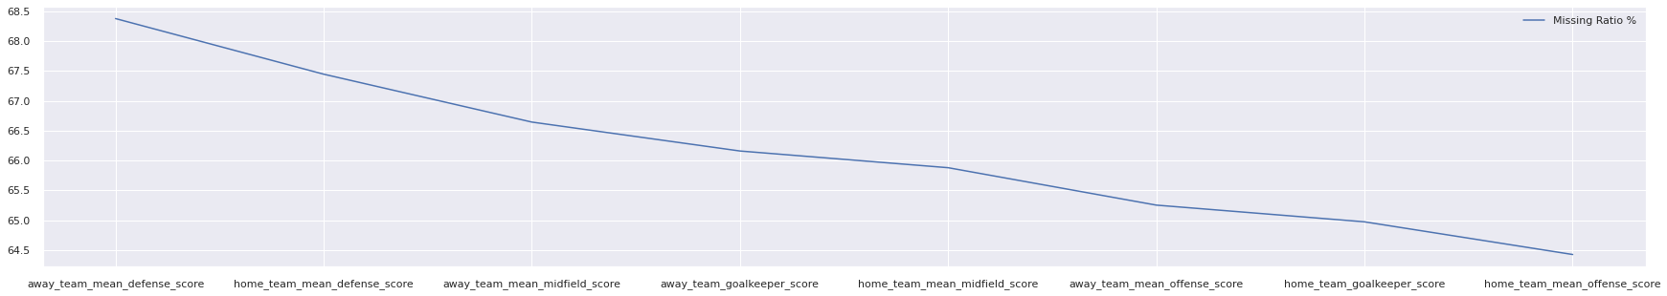
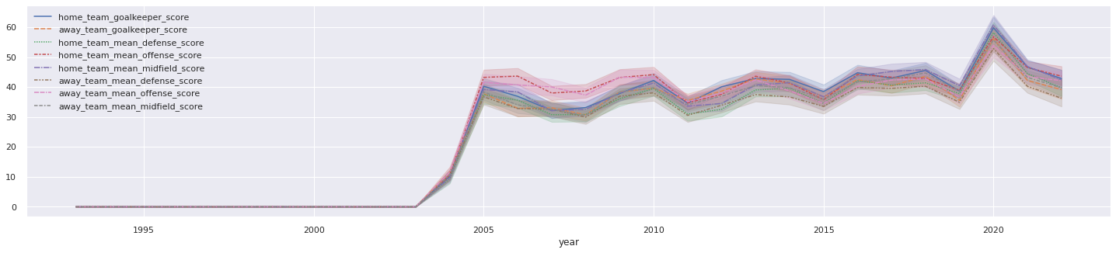
Data Preparation
Treating NAs
% of missing data from total data for each parameter in descending order
- 64%-68 % of total data is missing
scores
Data for scores is missing for years before 2004

Slide 8
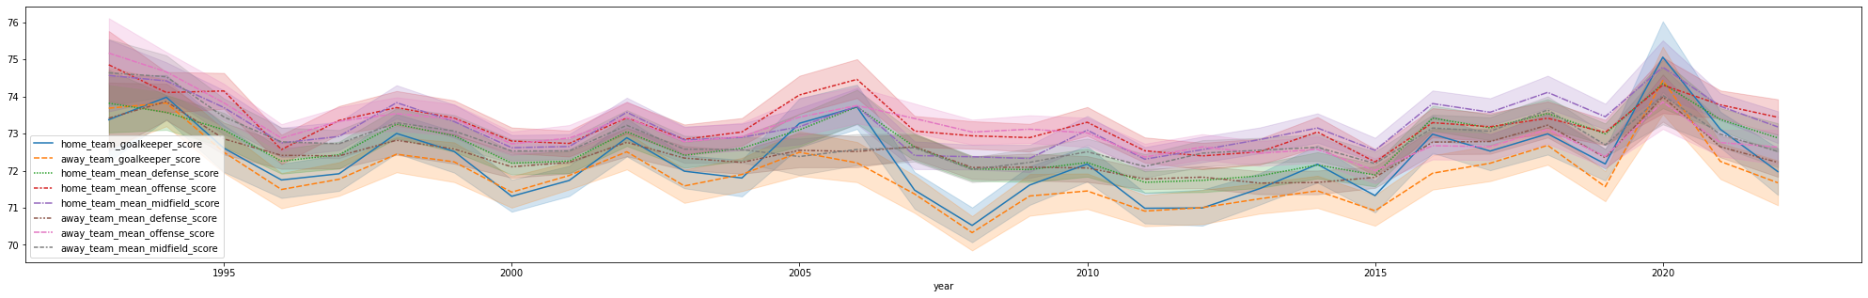
Data Preparation
Treating NAs
To keep the data normally distributed
Scores
groupby & fillna(mean())
NaN
mean
groupby : is used to calculate total score for each team within the data set
fillna(mean()) : is used to fill NA for each team by its own mean score

Slide 9
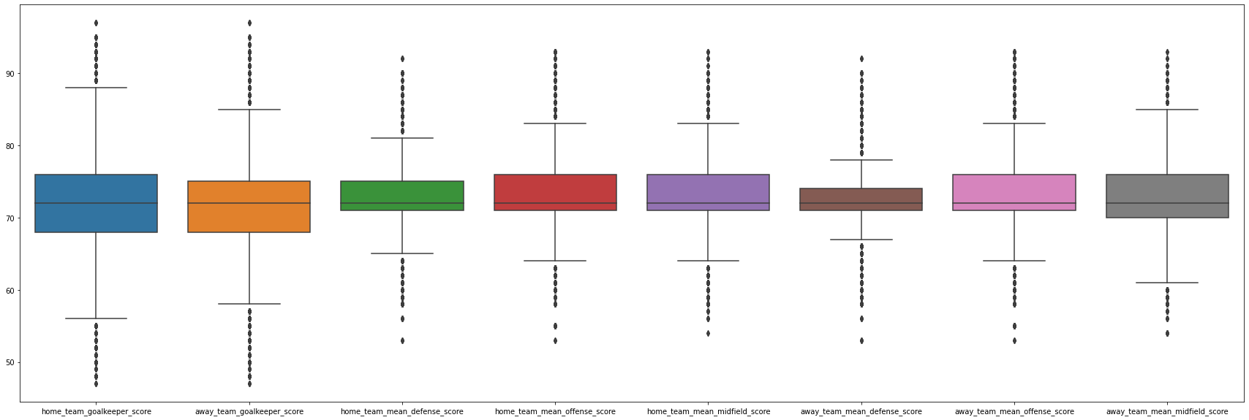
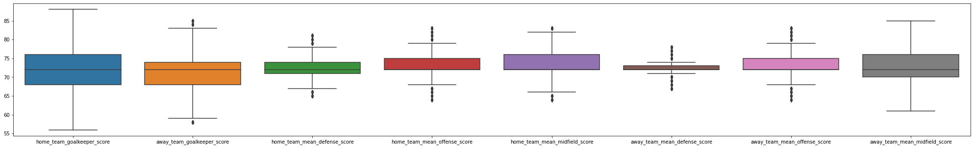
Data Preparation
Outlier treatment using IQR method
Before Outlier IQR treatment
After Outlier IQR treatment

Slide 10
Presentation headway
Business Findings
Key Insights
Correlations
Tableau Dashboard
By Prashant & Rishabh

Slide 11
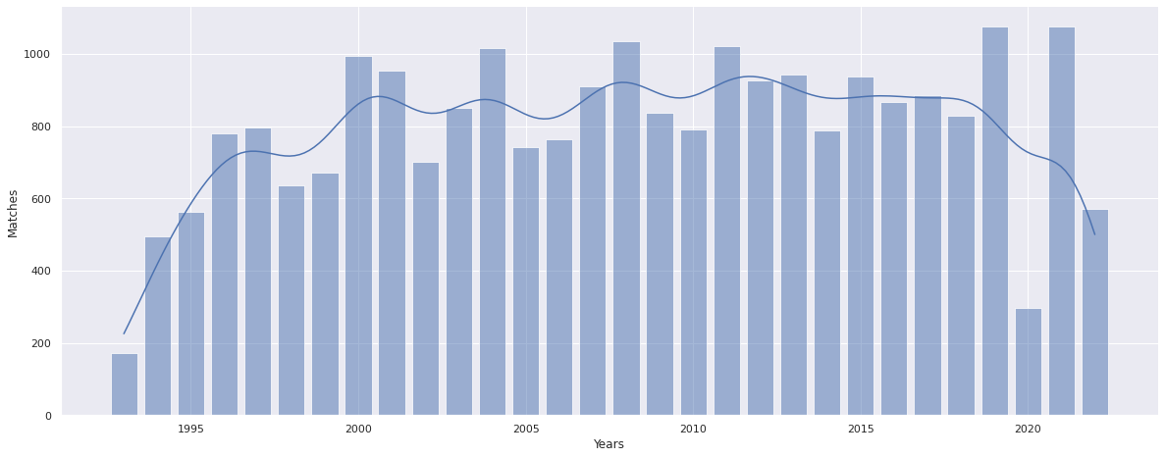
Exploratory Data Analysis
date
Distribution of number of matches played over 30 years
There are consistent peaks, identifying leagues and world cup matches.
There is also a dip seen in matches because on COVID lockdown in year 2020
Total number of Matches played seems stable in last decade, these matches may explode in next decade with greater interest shown by Asian population in football

Slide 12
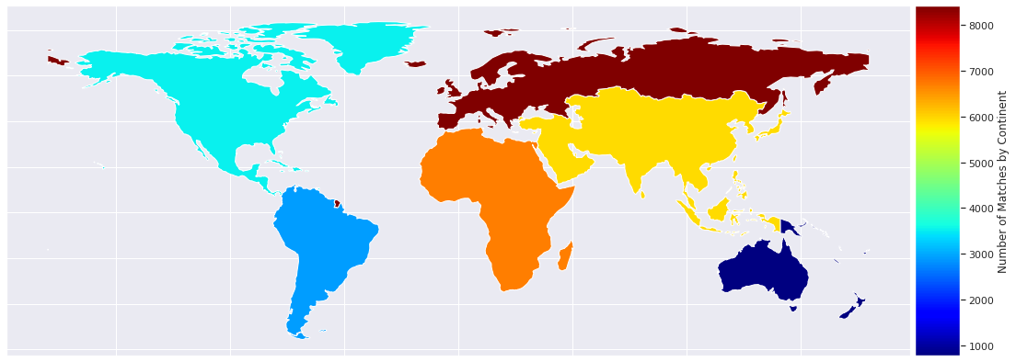
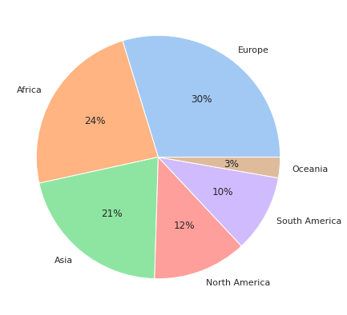
Exploratory Data Analysis
home_team_continent
away_team_continent
Continent playing highest number of matches
‘Continent’ may be good classifier to predict matches to be played but may not be effective to predict a win

Slide 13
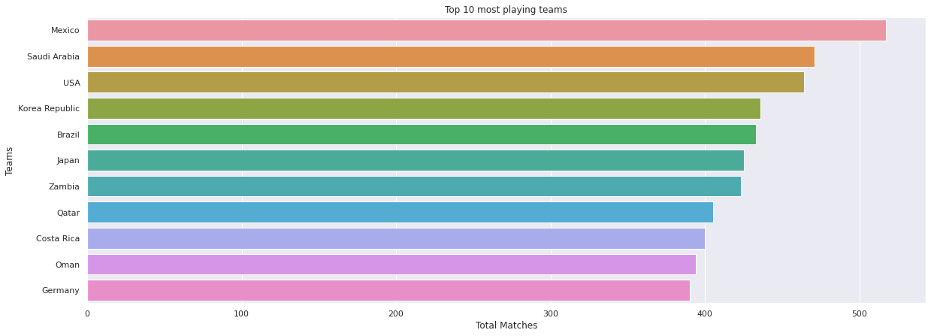
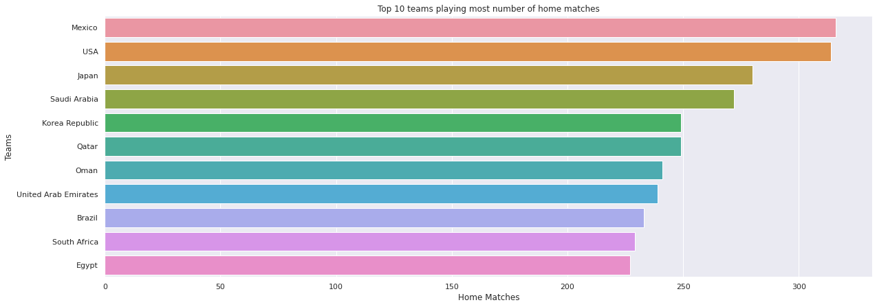
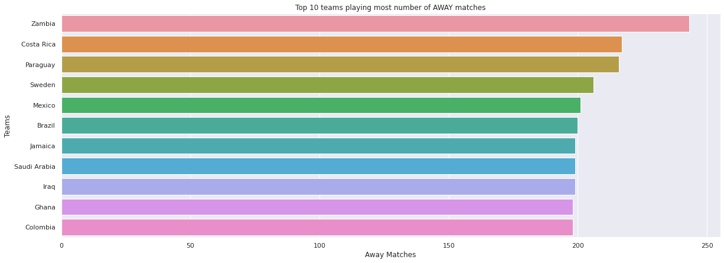
Exploratory Data Analysis
home_team
away_team
Top teams by matches played
Top teams playing highest number of TOTAL matches
‘Home’ and ‘Away’ matches may be good classifier to predict matches to be played but may not be effective to predict a win
Top teams playing highest number of HOME matches
Top teams playing highest number of AWAY matches

Slide 14
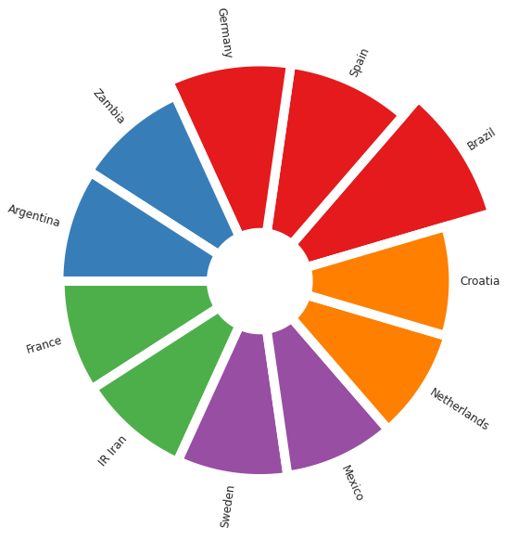
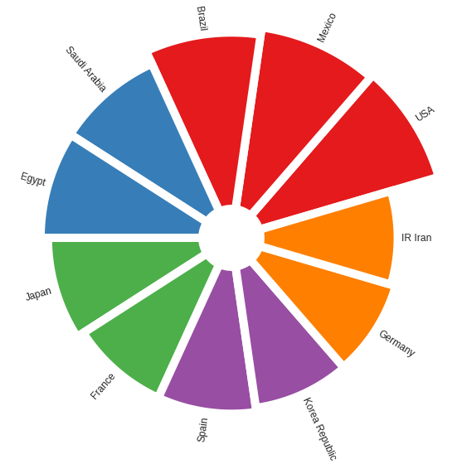
Exploratory Data Analysis
home_team
away_team
home_team_result
Top teams by matches won
Top teams which WON most AWAY matches
Top teams which WON most HOME matches
‘Home’ and ‘Away’ with ‘team result’ is able to classify top performers well

Slide 15
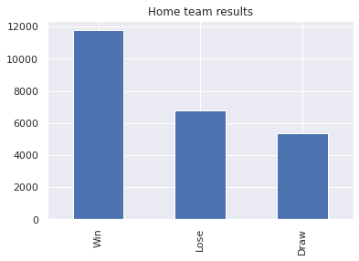
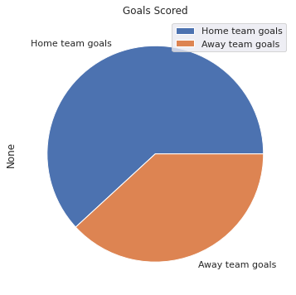
Exploratory Data Analysis
home_team
away_team
home_team_result
home_team_score
away_team_score
Home team advantage is real
A good classifier to state, if a team is playing its HOME match, then it may score more and be able to win the match

Slide 16
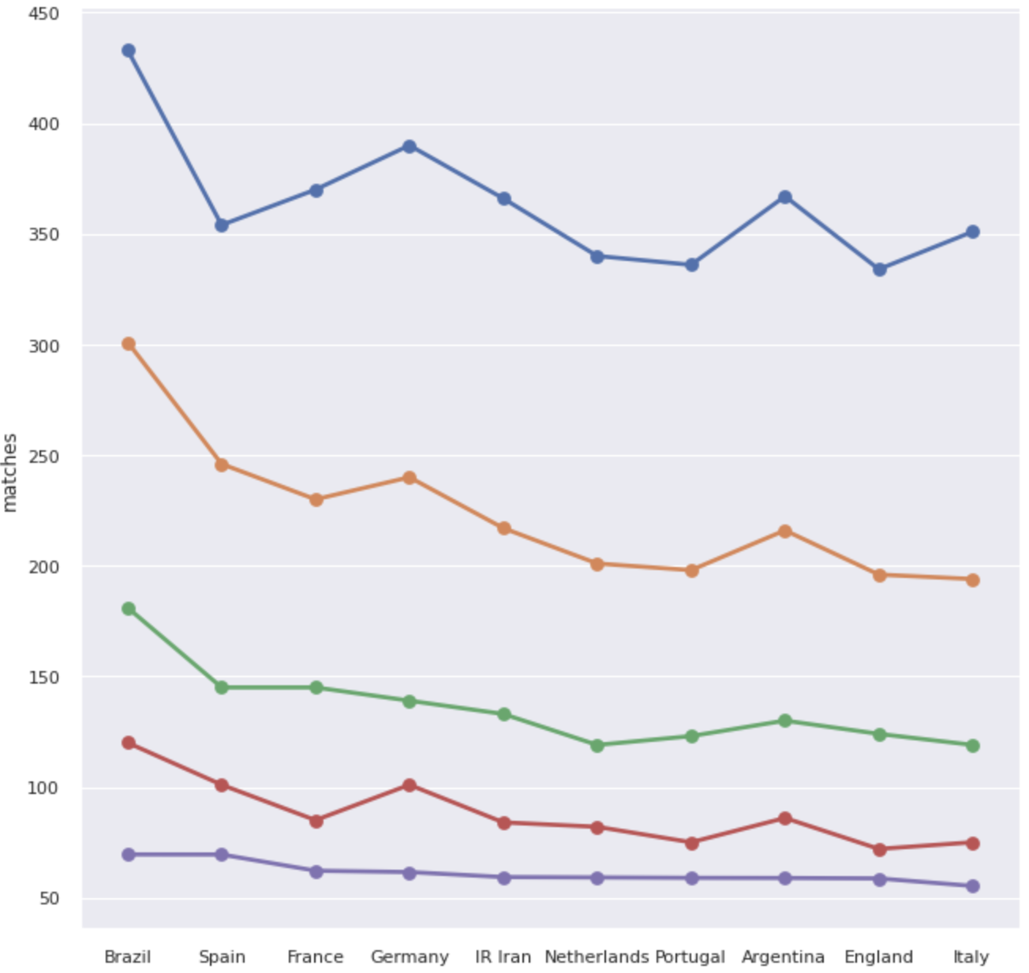
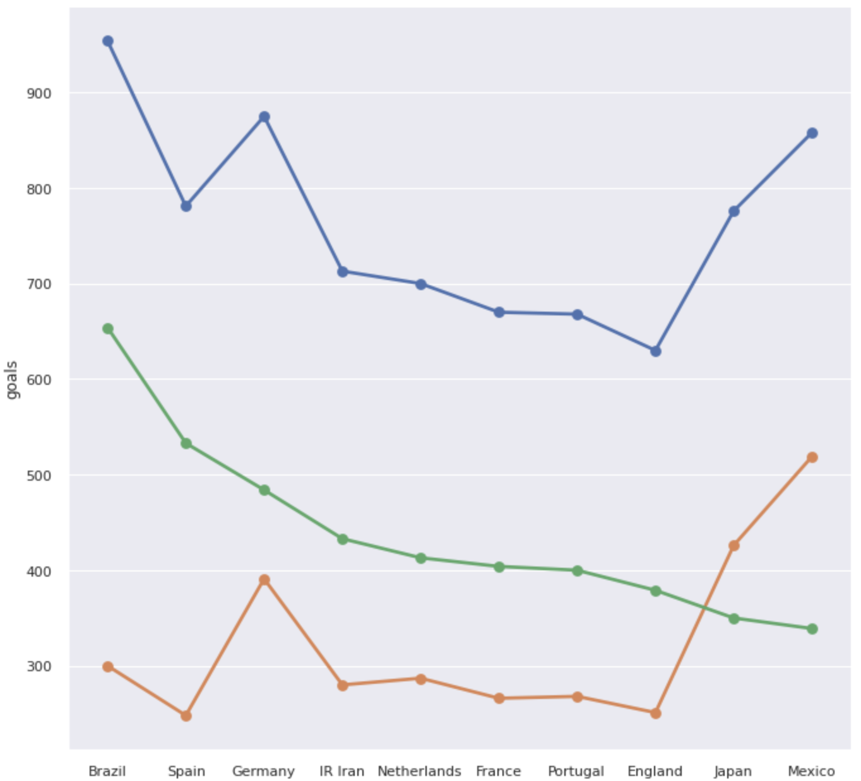
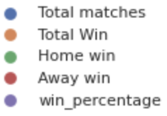
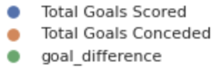
Exploratory Data Analysis
home_team
away_team
home_team_result
home_team_score
away_team_score
Team with Highest win percentage and goal difference
'Win percentage’ may not be great classifying parameter as almost same accross
‘Goals Difference’ appears to be a good classifying parameter

Slide 17
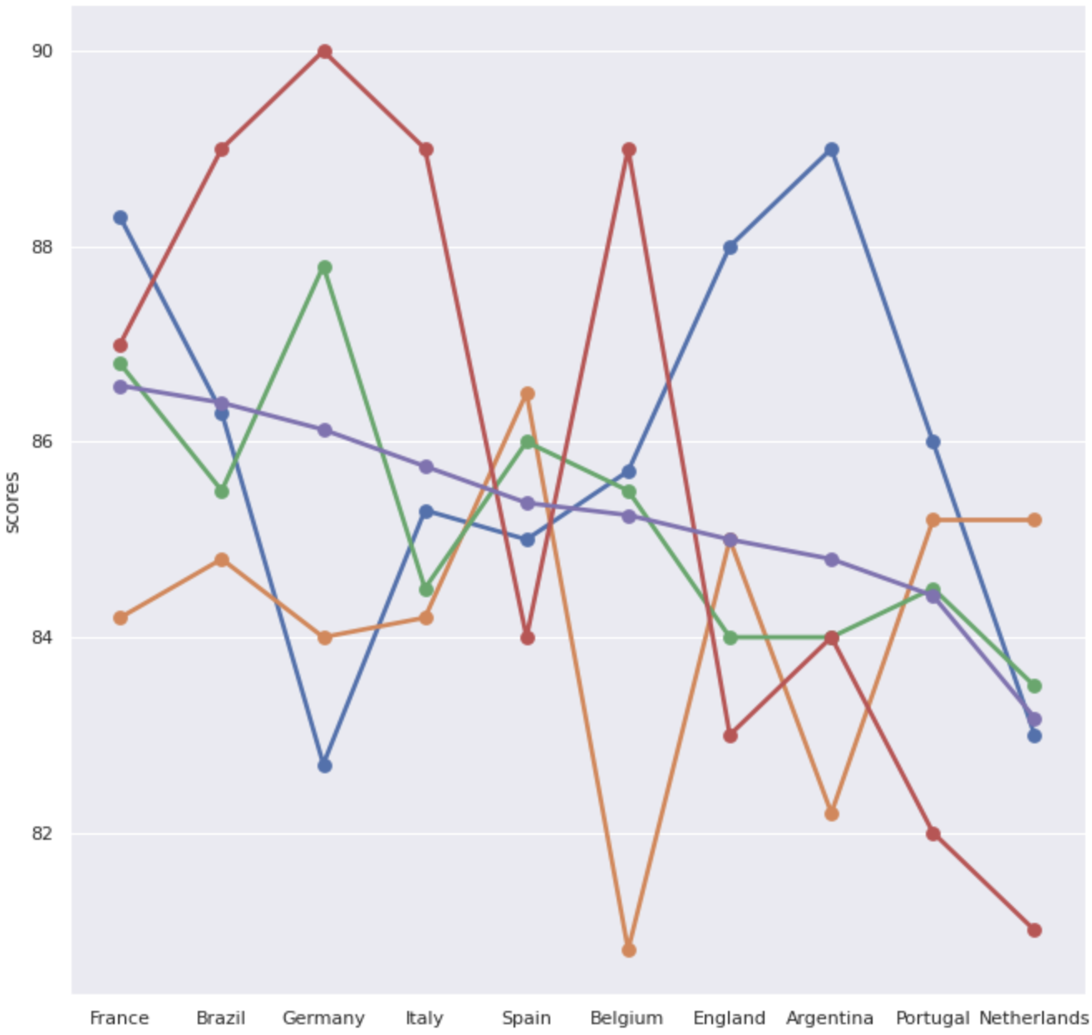
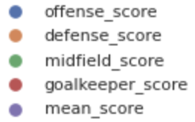
Exploratory Data Analysis
home_team_goalkeeper_score
away_team_goalkeeper_score
home_team_mean_defense_score
home_team_mean_offense_score
home_team_mean_midfield_score
away_team_mean_defense_score
away_team_mean_offense_score
away_team_mean_midfield_score
Team and their performance scores
Team Scores are very good predictors for the match. They help us understand respective team’s strength and weakness which can influence the outcome of the match between them.

Slide 18
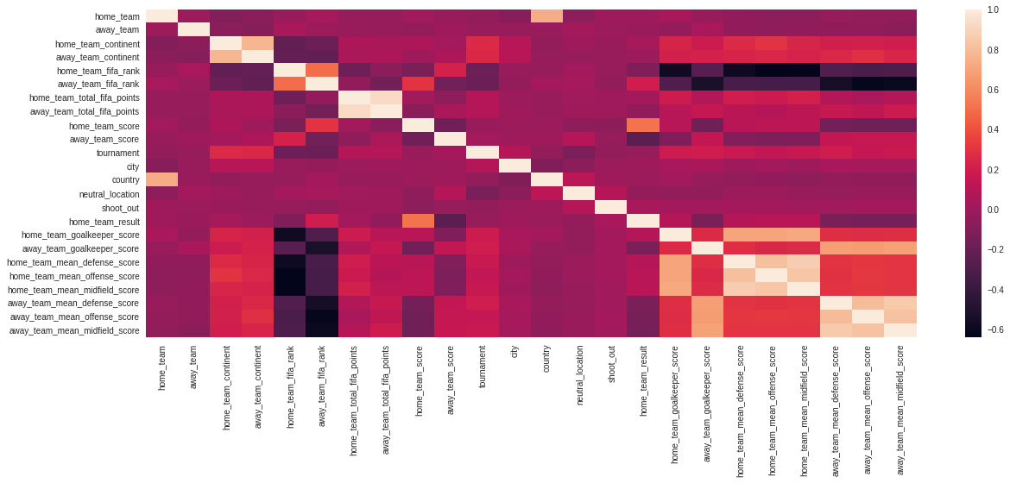
Exploratory Data Analysis
As also identified by the EDA, Home & Away match, Team Ranking and Team Scores are good predictors of result of the match
Correlations

Slide 19
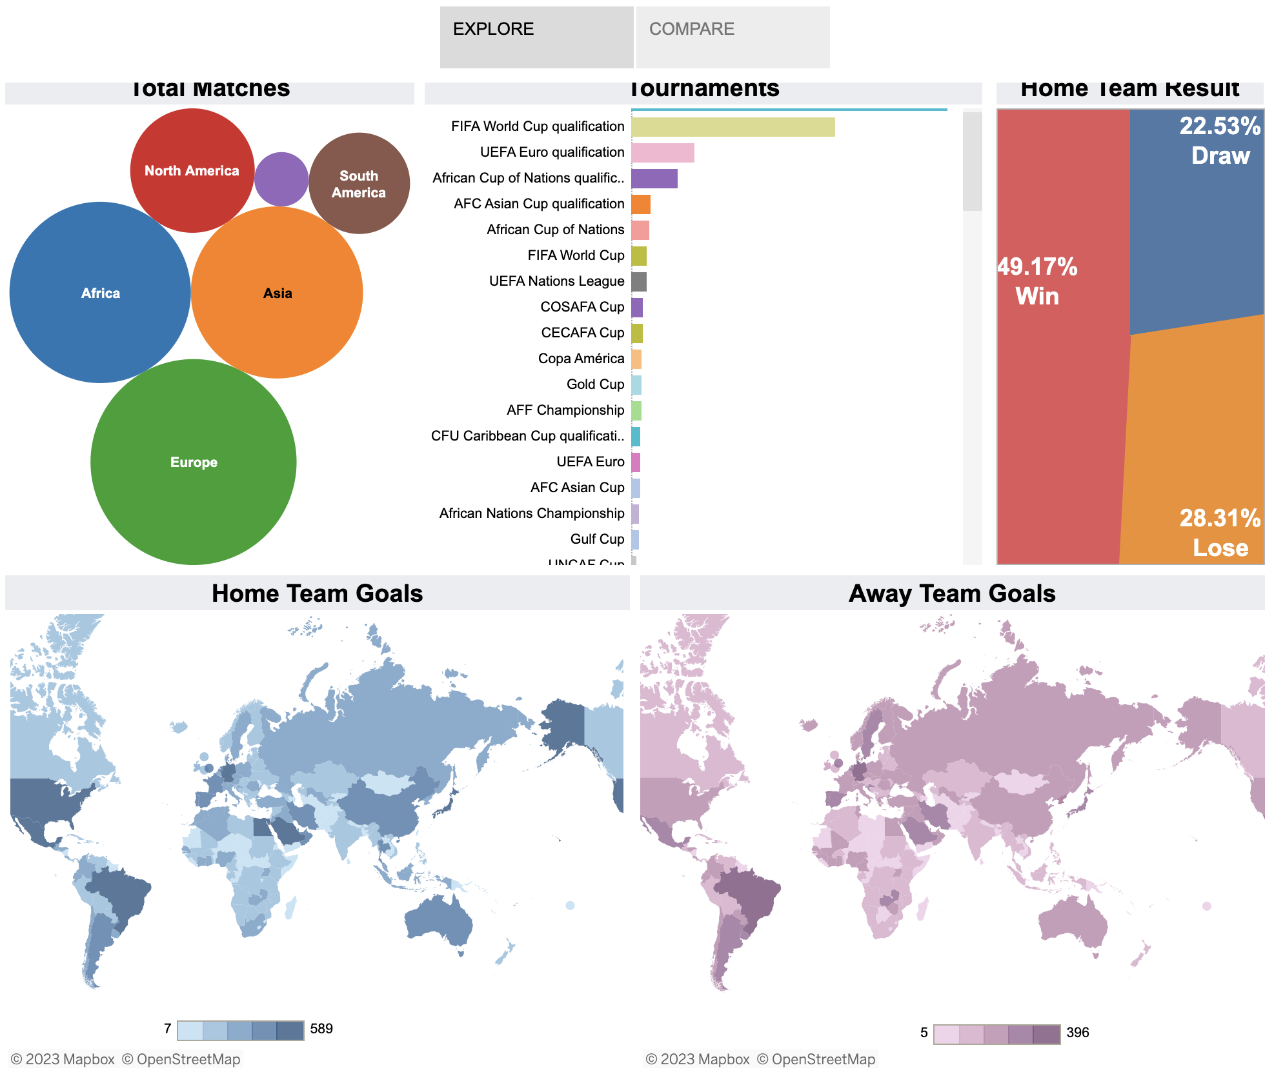
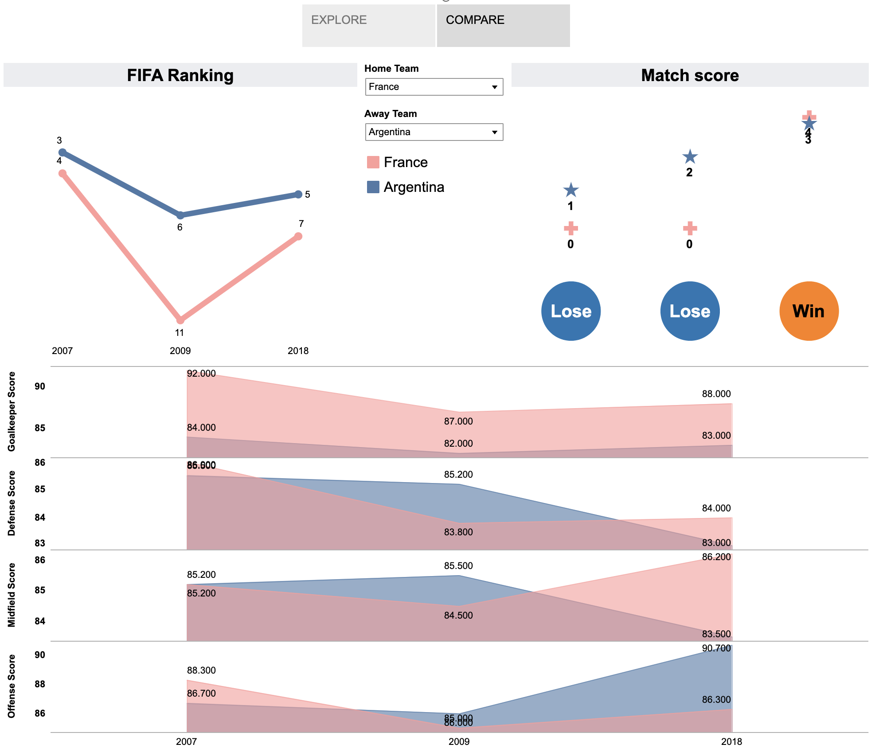
Exploratory Data Analysis
https://public.tableau.com/views/byop/Story1?:language=en-US&:display_count=n&:origin=viz_share_link

Slide 20
Presentation headway
Data split
Model Development
Model Evaluation and Accuracy
By Ankit & Rahul

Slide 21
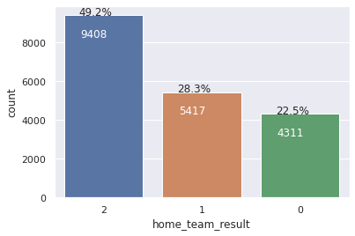
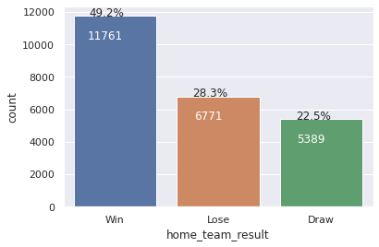

Model Development and Validations
Train- Test Split
Train dataset
Test dataset
Base dataset

Slide 22
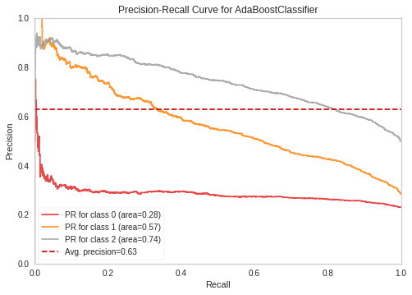
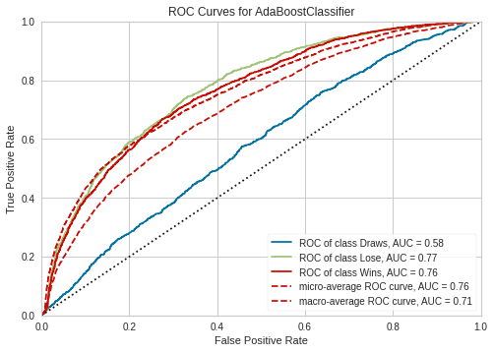
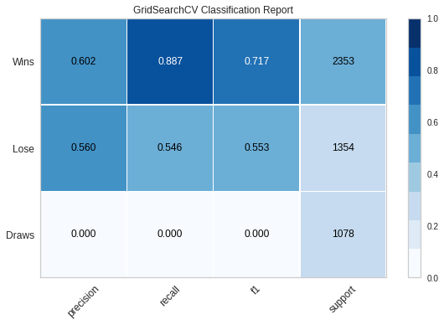
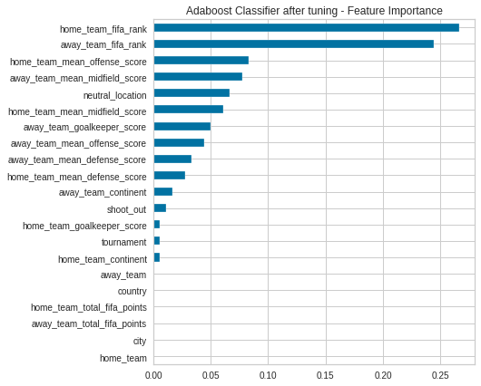
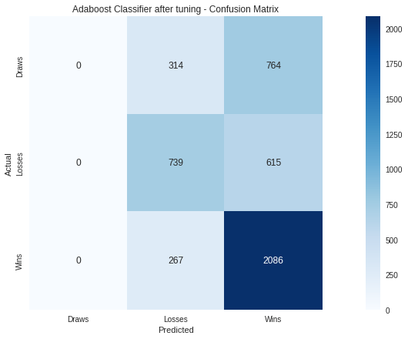
Model Development and Evaluations
Adaboost Classifier
Model Accuracy
59.04%

Slide 23
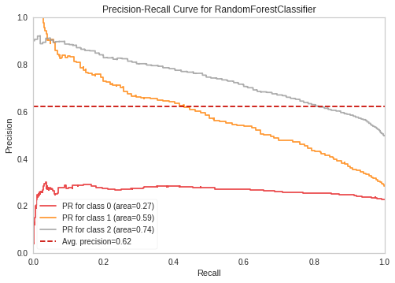
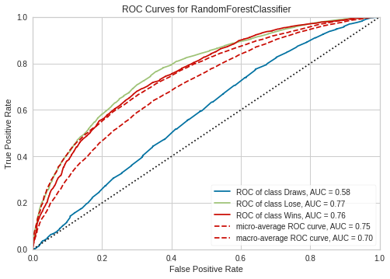
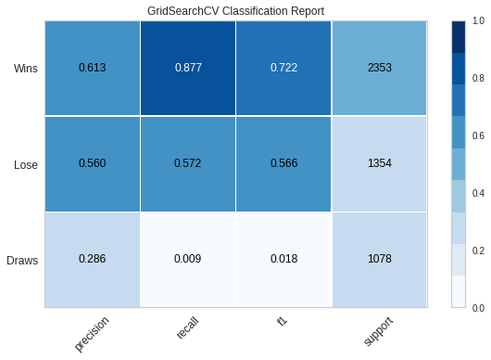
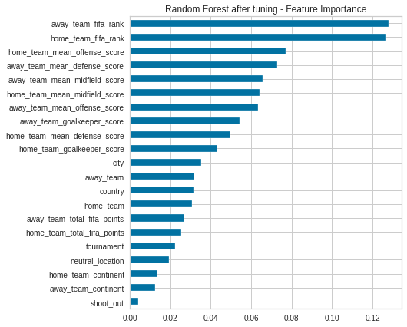

Model Development and Evaluations
Random forest classifier
Model Accuracy
59.51%

Slide 24
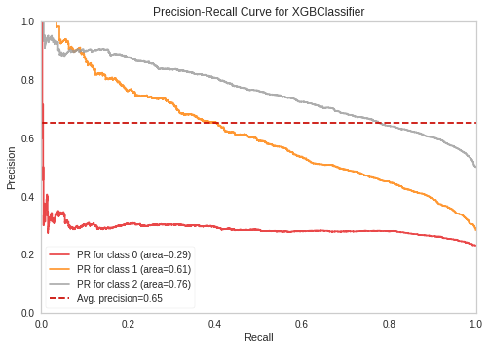
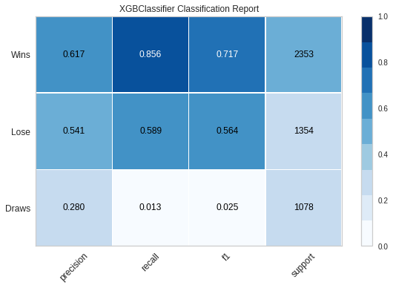
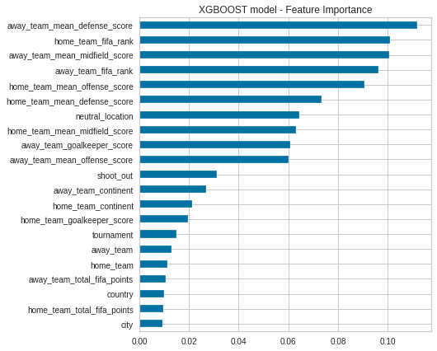

Model Development and Evaluations
Model Accuracy
59.01%
XGB Classifier
Mean CV
59%
K-Fold CV
59%

Slide 25
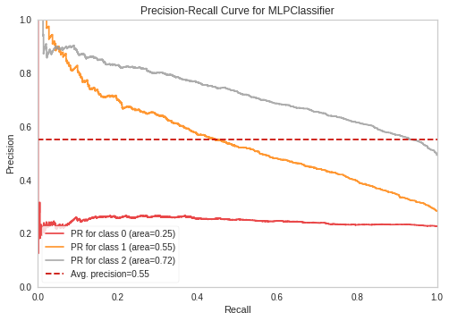
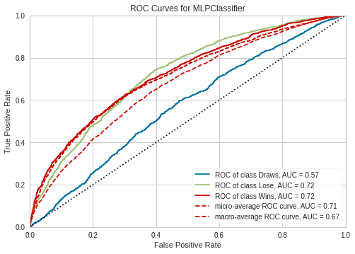
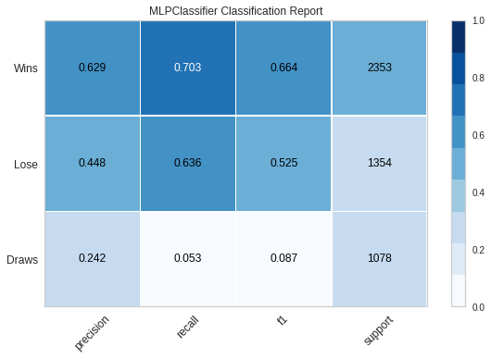
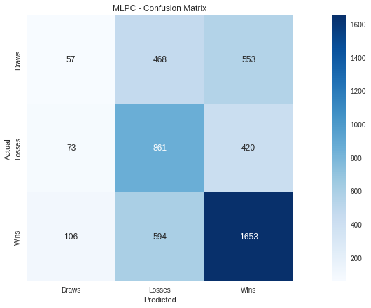
Model Development and Evaluations
MLP NN Classifier
Model Accuracy
53.73%

Slide 26
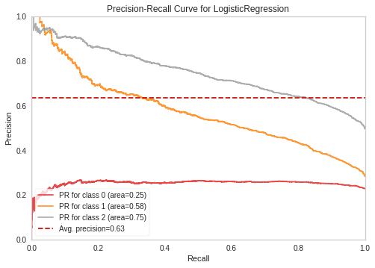
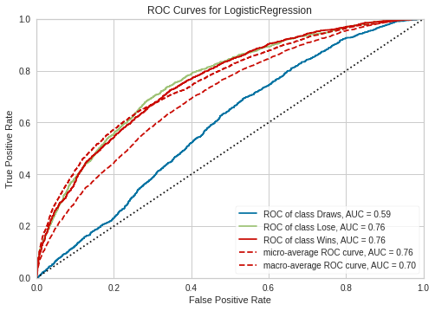
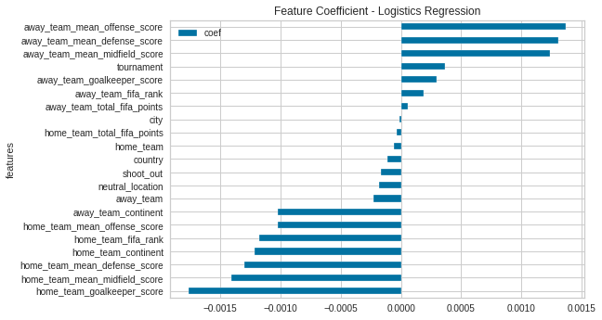

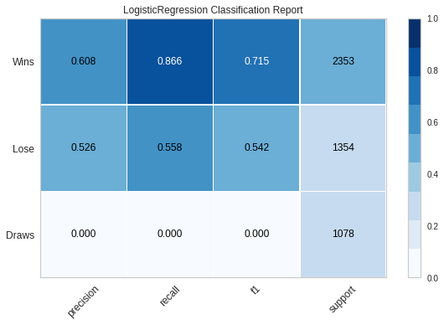
Model Development and Evaluations
Logistics Regression
Model Accuracy
58.36%

Slide 27
Presentation headway
Live tracking & Simulations
Business conclusions
By Sachin

Slide 28
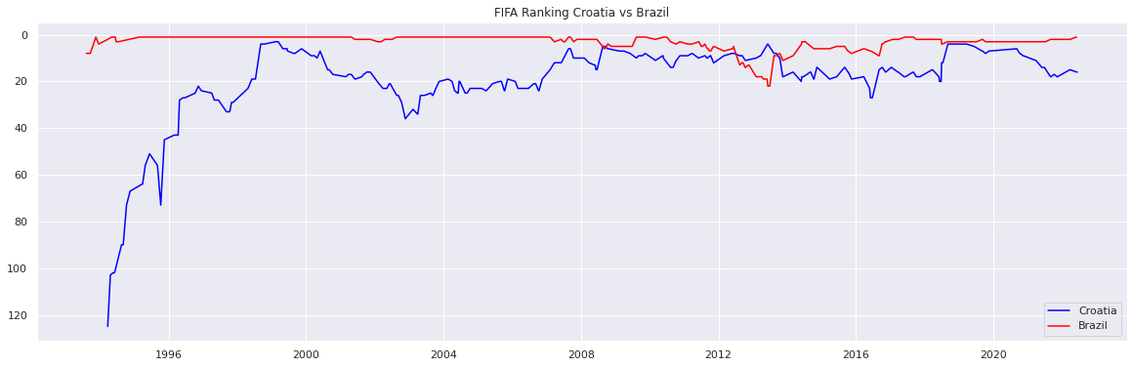



Live tracking / Match Simulation
home_team_fifa_rank
away_team_fifa_rank
Quarter Finals – Croatia vs Brazil
Won
Prediction Failed
scores
goal difference

Slide 29





Live tracking / Match Simulation
home_team_fifa_rank
away_team_fifa_rank
Quarter Finals – Netherlands vs Argentina
Won
Prediction Passed
scores
goal difference

Slide 30




Live tracking / Match Simulation
home_team_fifa_rank
away_team_fifa_rank
Quarter Finals – Morroco vs Portugal
Won
Prediction Failed
scores
goal difference

Slide 31




Live tracking / Match Simulation
home_team_fifa_rank
away_team_fifa_rank
Quarter Finals – England vs France
Won
Prediction Passed
scores
goal difference

Slide 32



Live tracking / Match Simulation
home_team_fifa_rank
away_team_fifa_rank
Semi Finals – Argentina vs Croatia
Won
Prediction Passed
scores
goal difference

Slide 33



Live tracking / Match Simulation
home_team_fifa_rank
away_team_fifa_rank
Semi Finals – France vs Morocco
Won
Prediction Passed
scores
goal difference

Slide 34



Live tracking / Match Simulation
home_team_fifa_rank
away_team_fifa_rank
Third Position Playoffs– Croatia vs Morocco
Won
Prediction Passed
scores
goal difference

Slide 35



Live tracking / Match Simulation
home_team_fifa_rank
away_team_fifa_rank
Finale– Argentina vs France
Won
Prediction Failed
scores
goal difference

Slide 36
Business Conclusions
xxxxxxxxxxxxxxxxxxxxxxxxxxxx
ML Models giving approx. 60% accuracy
Live tracking and manual simulation gave around 62% accuracy,
Total Simulation = 8
Prediction passed = 5 (62%)
Prediction failed = 3
Good prediction given the limited set of data.
There will always exist some parameters which cannot be predicted and are more human being prone than the data.
That’s what makes this sports addictive
ML and Data analytics will continue to have a greater importance in sports and its allied business.
With such business analytics businesses can aligned their event, promotion, expenditure activities more effectively

Slide 37
Thank You

Slide 38





Model Development and Evaluations
Decision Tree classifier
Model Accuracy
55.31%

Slide 39





Model Development and Evaluations
SVC Classifier
Model Accuracy
58.14%

Slide 40




Model Development and Evaluations
K Neighbors Classifier
Model Accuracy
49.10%

